Slide 1
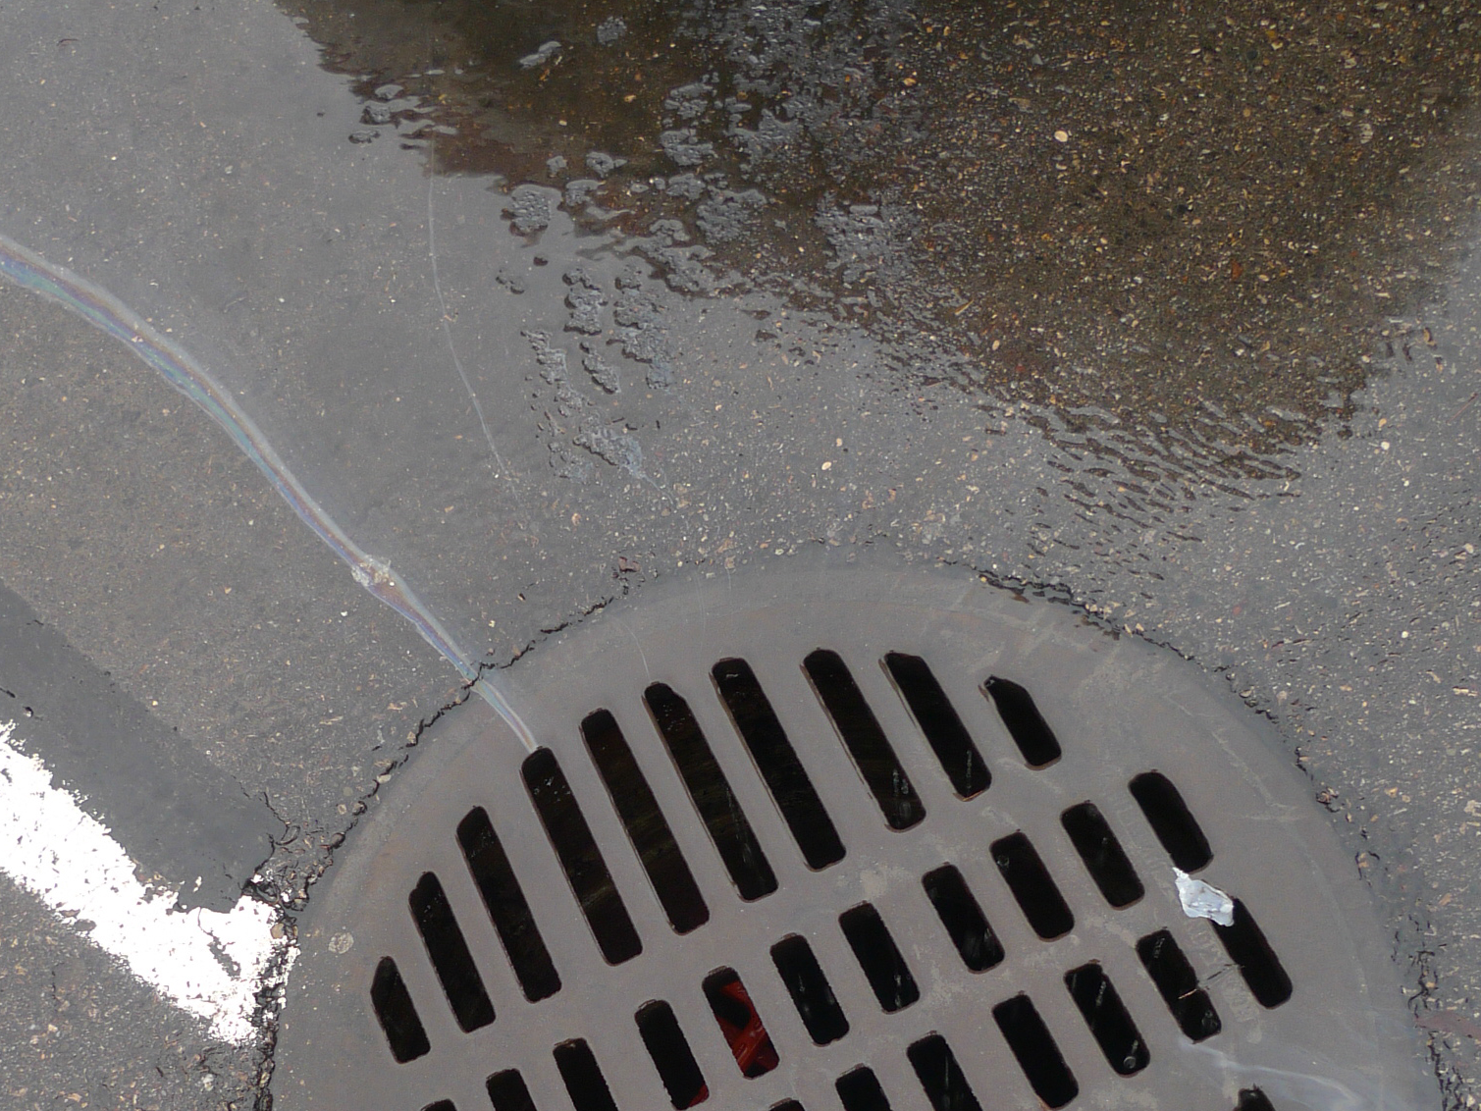
The Problem
Impervious surfaces account for nearly 20% of the land in the Chesapeake Bay Watershed. These include roads, sidewalks, and roofs. Runoff from these surfaces carry toxins and other pollutants into the bay.

Slide 2
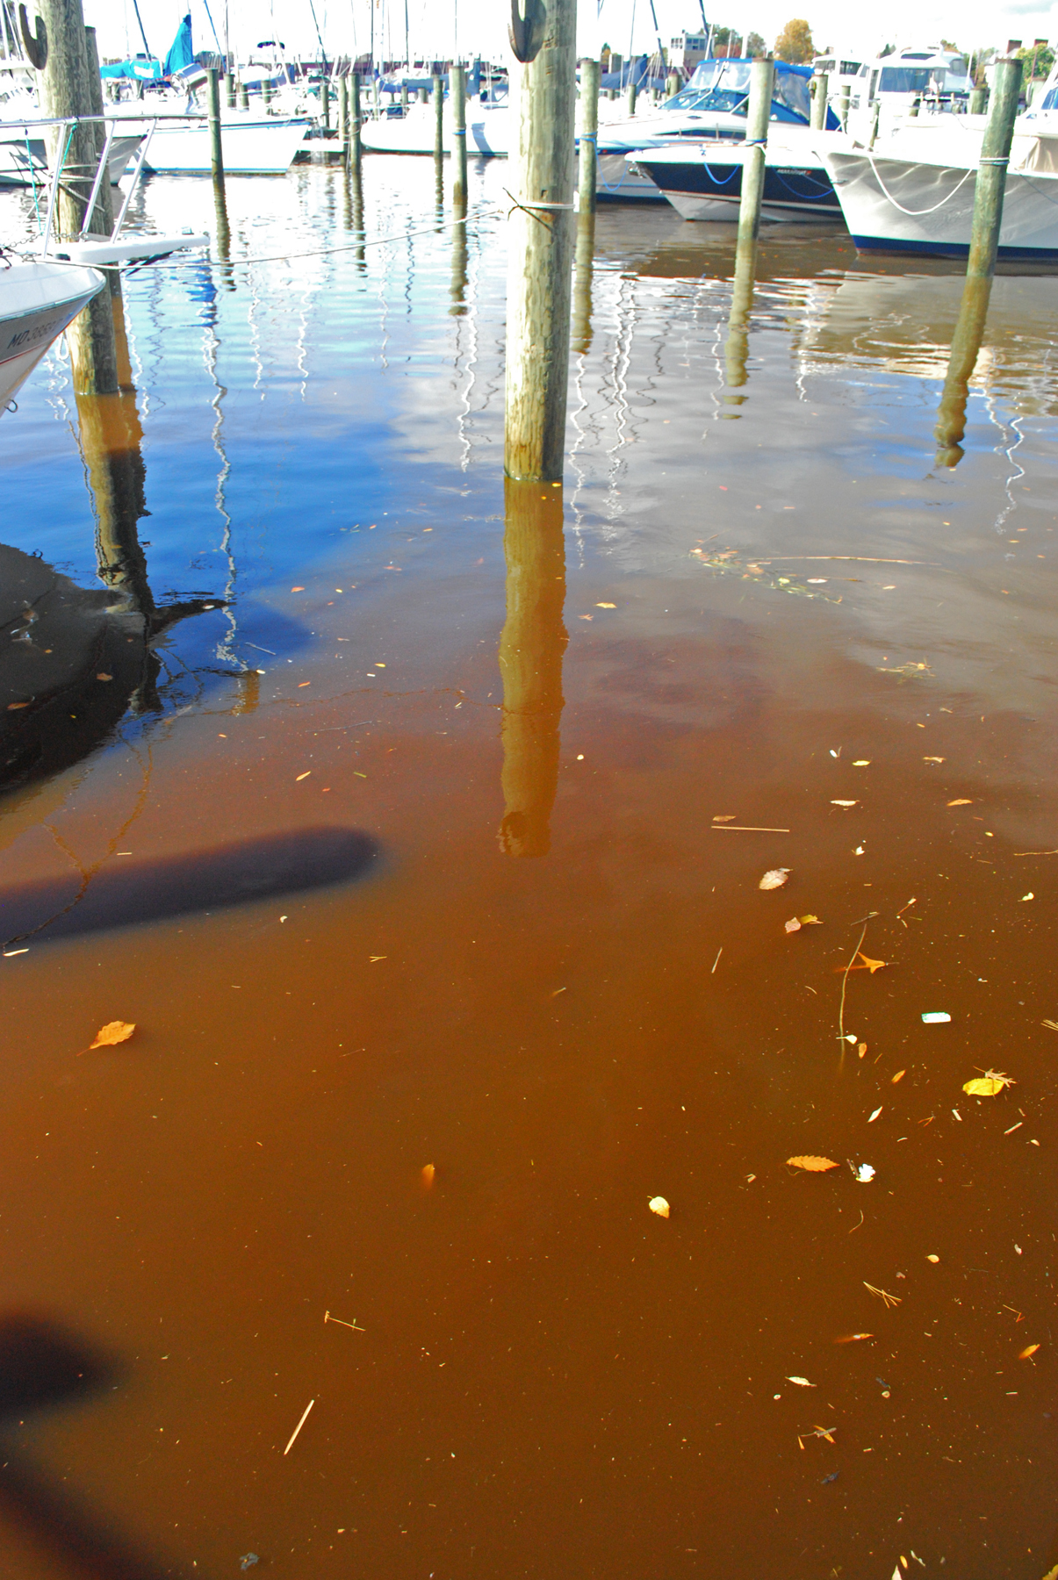
Consequences
Increases Stream Bank Erosion
Impervious surfaces increase water flow, causing flooding and stream bank erosion. Sediments from the erosion block sunlight for underwater plants and destroy bottom habitat for aquatic life.
1
Decreases Water Quality
Water that flows across impervious surfaces picks up chemicals, pesticide, and sediments. These pollutants cause harm to humans and aquatic life.
2
Increases Water Temperature
Rain water heats up when it falls onto impervious surfaces. Warmer water carries less oxygen, which can stress and even kill many stream inhabitants.
3

Slide 3
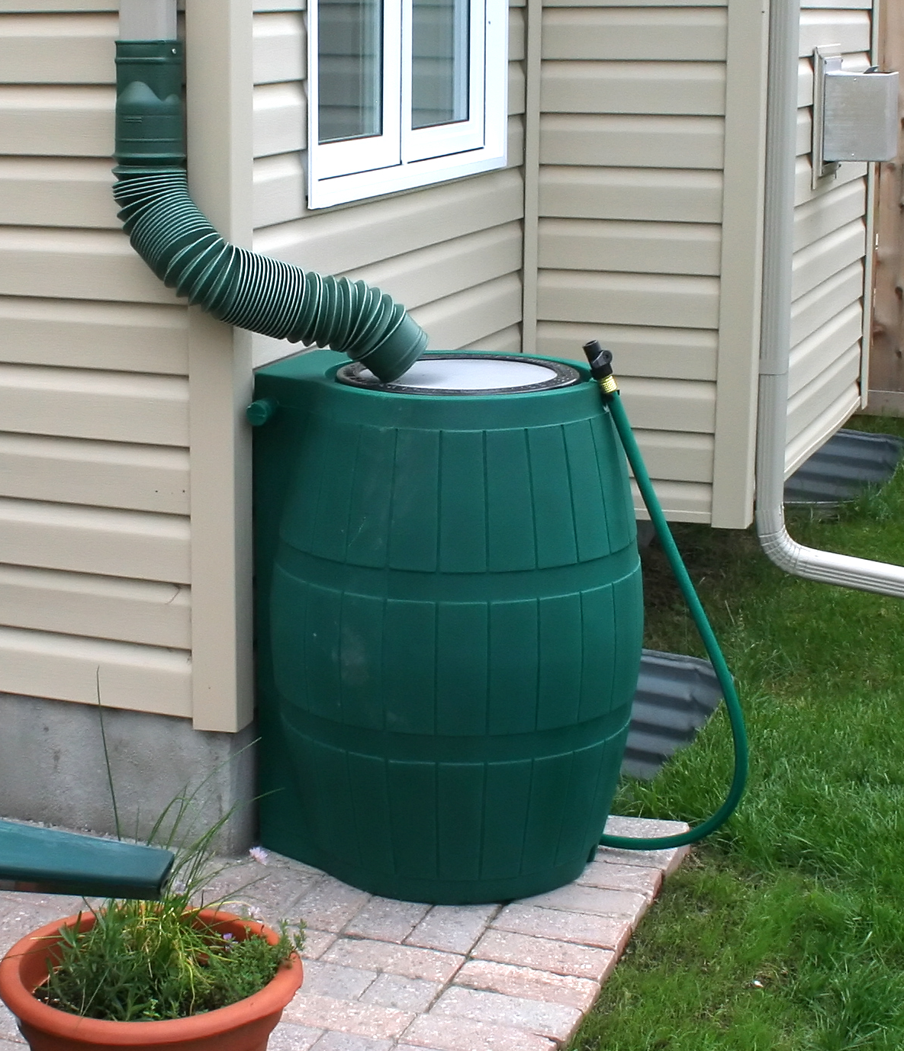
1
What Can You Do about It?
Use Rain Barrels
Place a rain barrel under your downspout to capture runoff.
This reduces erosion and improves water quality in our streams. You can use the water stored in the rain barrel to water your garden and lawn!

Slide 4
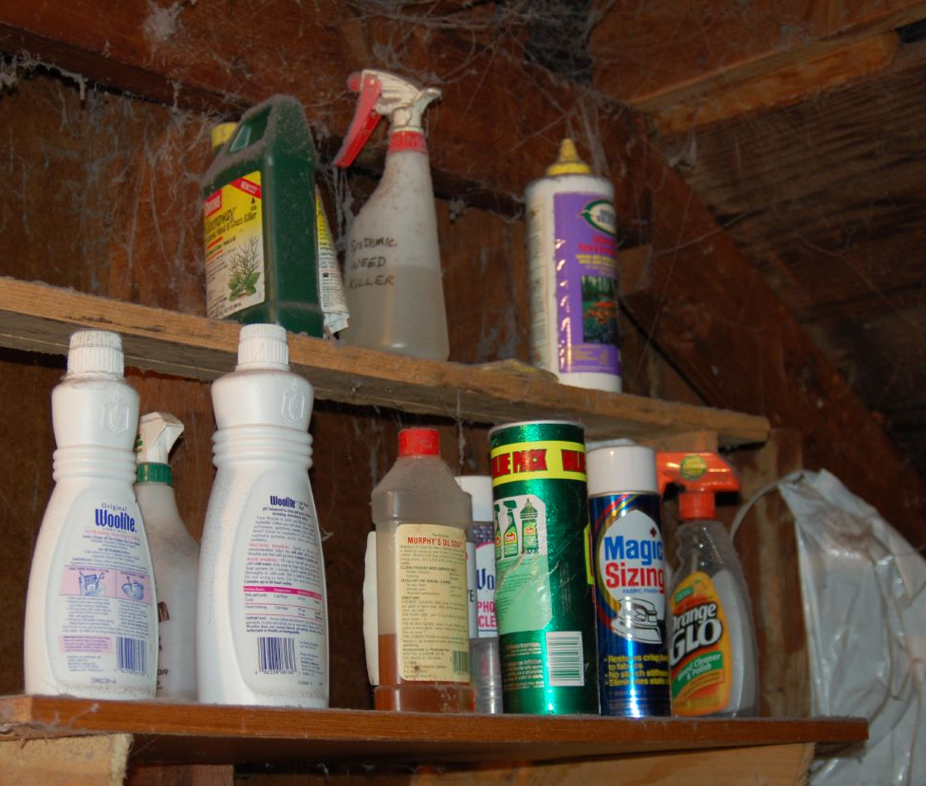
2
What Can You Do about It?
Use and Dispose of Chemicals Wisely
Minimize household hazardous waste:
choose non-hazardous products
only purchase the amounts you need
share any leftover amounts
Keep these toxins from polluting the Bay by properly disposing of them! Contact your local government agency to find out how.

Slide 5
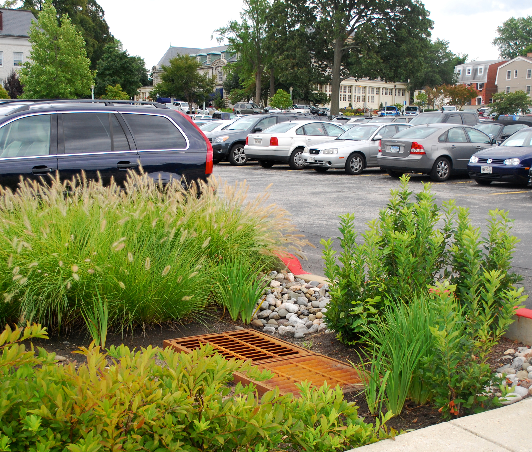
3
What Can You Do about It?
Reduce Impervious Surfaces
Plant Trees
Tree roots help to slow water flow on your property. Trees can absorb up to 14 times more rainwater than grass and don’t require fertilizer.
Plant a Rain Garden
Rain Gardens are designed to slow down and absorb runoff. The native plants help to filter out pollutants before they enter the groundwater.

Slide 6
Credits
Photos used under Creative Commons licenses:
https://creativecommons.org/licenses/by-sa/2.0/legalcode
“Oily Runoff” by Thirteen of Clubs via flickr.com (cropped)
https://creativecommons.org/licenses/by/2.0/legalcode
“The Rain Barrel” by Ian Mackenzie via flickr.com (cropped)
https://creativecommons.org/licenses/by-nc/2.0/legalcode
“Mahogany Tide” by Chesapeake Bay Program via flickr.com (cropped)
“Storing Cleaning Supplies” by kqedquest via flickr.com (cropped)
“Rain Garden in Parking Lot” by Chesapeake Bay Program via flickr.com (cropped)

